Slide 1
Gene editing - CRISPR/Cas9 System
Veljko Zdjelar 4-11

Slide 2
Recap of gene editing before CRISPR

Slide 3
First It Was Nature
Perhaps the oldest record of gene editing we had contact with was the transformation of wolves into dogs.
All it took was for one wolf to get too close to the fire, take the food and be just fine. Then that same wolf would come back with others, being led by an example.
The shift was happening for quite some time as adaptation set in, switching out, for example, big and pointy ears and bigger and sharper fangs with its modern counterparts.
Some millennia later we have hundreds of dog breeds, 339 to be exact as recognized by the World Canine Organization.

Slide 4
Then We Tried Something Unorthodox
As we kept expanding our knowledge of DNA, specifically mutations within the DNA, scientists figured out that we can make our own deliberate mutations by exposing organisms to large amounts of radiation.
By nature mutations are completely random, they can be either useful or not so useful, which of course varies on the desired function.
After that sneak peak into what gene editing could be, advancements were much more frequent and kept pushing the envelope even more.

Slide 5
And Finally We Got Really Into It
During the 90’s, researchers found that certain eukaryotes have the ability to make changes in their genes using nucleases, enzymes that cleave parts of DNA, later using an associated zinc finger to add a desired DNA sequence.
That method is called zinc-finger nuclease or ZFN for short.
Later we had a similar enzyme type method called TALEN (transcription activator-like effector nuclease) which was a bit more flexible the ZFNs in a way that they had a separate DNA binding domain that had a wider effective range.
Also, a method using viruses was developed (rAAV or recombinant adeno associated viruses) that with its enzyme counterpart used viruses to introduce new DNA sequences.

Slide 6
The Discovery of CRISPR

Slide 7
Again, It Came from Nature
CRISPR is actually a defensive mechanism that bacteria use to fight off viruses that attack bacteria, bacteriophages.
The bacteria has 3 stages where it can defend itself from the virus, 1 before it enters the cell and 2 after, and if the virus is stopped in the latter 2 stages, part of the viruses DNA will be kept in the cells DNA archive, CRISPR (Clustered Regularly Interspaced Short Palindromic Repeats).
After additional research we found out that we can designate which sequences can be cut out with incredible precision.

Slide 8
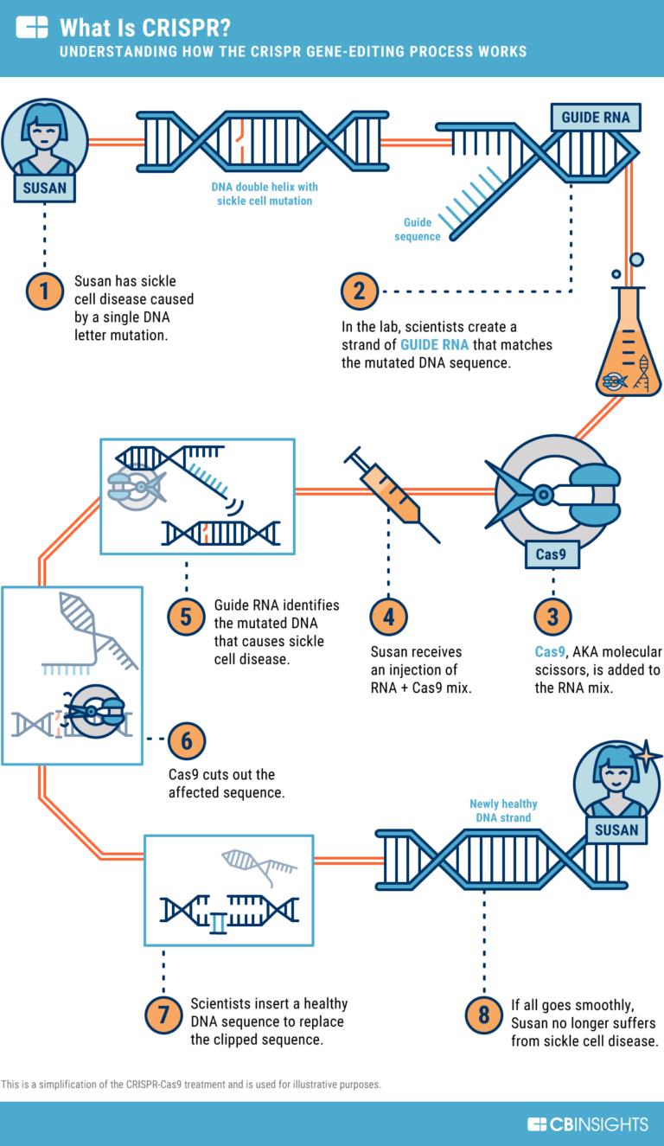
The Way It Works
CRISPR works in a way that when a DNA sequence is recognized from the archive a RNA copy of it gets printed and it goes trough the enzyme Cas9.
Later, the DNA and the “guide RNA” are compared and if a match is found the part of the DNA is cut out. And this is achieved with incredible accuracy.
If we use sickle cell anemia as an example, that is a genetic defect that occurs on a single base pair, if we use CRISPR we can just set the DNA sequence to be the mutated pair and, if we have to, go trough the patients whole DNA strand, and just like that the defect is gone.

Slide 9
Kick-outs
Kick-out is essentially a fancy word for cutting out genes, and it works on the cells innate NHEJ (Non homologous end joining) repair mechanism.
It sets in after the initial cut as it binds the double strands back together.
It is prone to mistakes in a sense that I can add or delete nucleotides. If the number of inserted or deleted nucleotides is not divisible by 3, it will induce a frame shift mutation and most likely terminate the gene.

Slide 10
Kick-ins
The more interesting part of this whole gene editing method, the kick-in are insertions of new genes into an existing genome.
Similarly to kick-outs, the HDR (homology direct repair) is the workhorse of this mechanism.
This is accomplished by adding a homologous DNA template with the desired traits into the cell, with the other necessary CRISPR components.
After a certain number of cells use this template through homologous recombination the added trait will be put in effect.

Slide 11
Achievements and Ethics

Slide 12
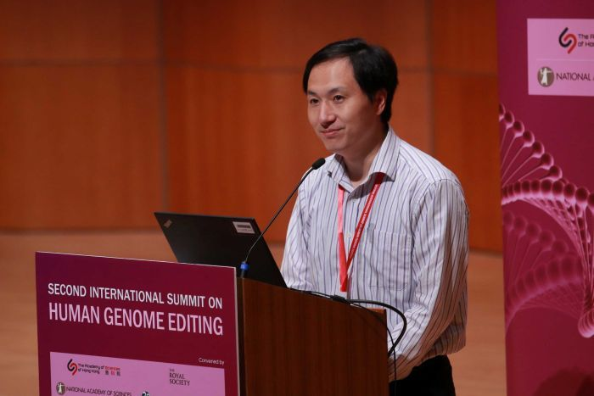
Current Achievements
The most famous, or infamous, achievement made by CRISPR were the CRISPR babies, one of the first times this method was used on humans.
The experiment was conducted by a Chinese scientist He Jiankui.
His goal was to suppress a gene called CCR5, which is responsible for creating proteins that allow the HIV virus to enter cells.
So far we know that this was done to two twin girls, and one more baby like this is suppose to be born later this year.
Due to Chinese censorship, there isn’t much more information out there, besides His medical license being put into question, due numerous claims on the ethics of this experiment.

Slide 13
Ethical Questions
With CRISPR providing ground breaking advancements into gene editing this opens an endless amount of opportunities.
On the defence of the use of this method, if we have the chance to save someone`s life even before that person is born by eliminating a hereditary defect, why shouldn`t this be used?
But on the contrary there are a bit more arguments.
As Machiavelli put: ‘All power corrupts, and absolute power corrupts absolutely.’
Who are humans to play God and, will regulations really stop certain people from overworking this system?
Only time will tell and the least we can do is stay optimistic and reasonable

